Slide 1
Knowing about model’s evaluation through literatures
Ruichen MA
2024/8/26

Slide 2
Motivation
An important part of large model training
Possibly future work

Slide 3
Evaluation: Two steps
Running benchmark test on the model
Analyzing the output

Slide 4
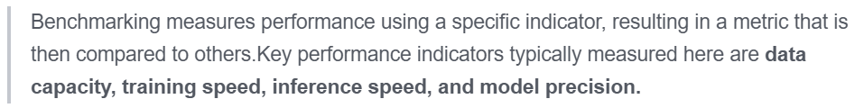
What is a benchmark?
Benchmark ≈ dataset + task

Slide 5
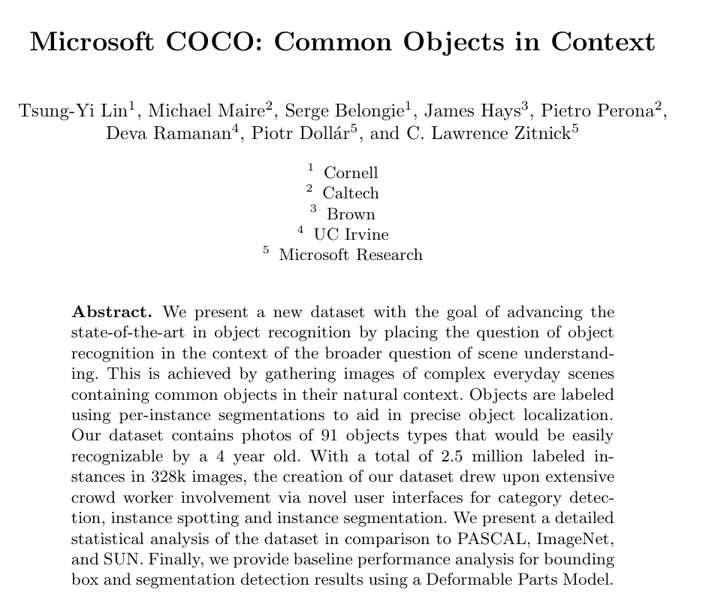
Let’s focus on building a dataset
49137cites

Slide 6
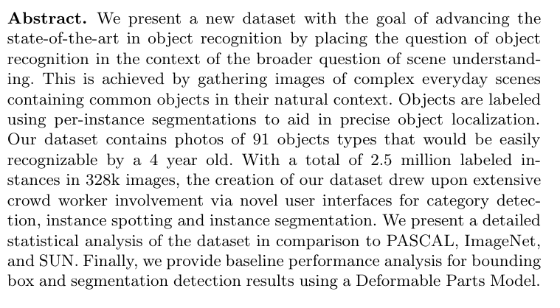

Slide 7
Read by parts
1. introduction
2. related work
3. image collection
4. image annotation
5. dataset statistics
6. algorithmic analysis
7. discussion

Slide 8
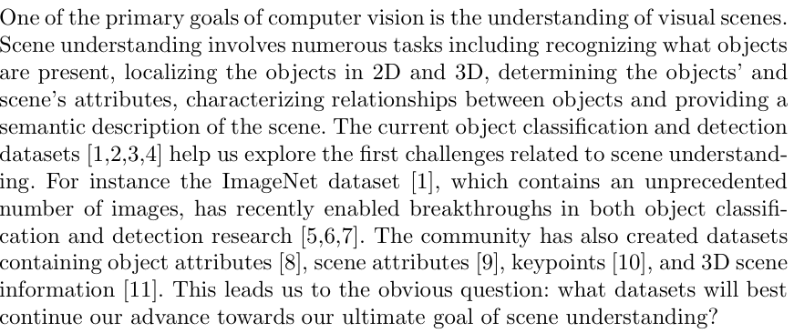
1. introduction

Slide 9
introduction
A large dataset featuring non-iconic views
Designed for contextual reasoning
Unique annotation
91 categories, 328000 images, 2500000 instances
Comparing with ImageNet, PASCAL VOC and SUN

Slide 10
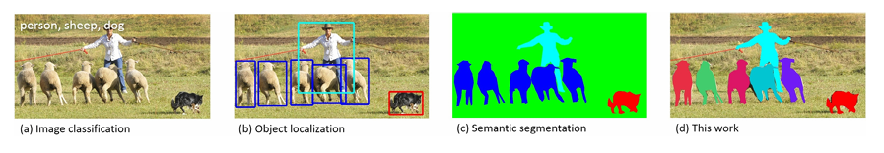
Related work
Previous datasets divided into three categories:
Image classification
Object detection
Semantic scene labeling
Others

Slide 11
Image collection
Common object categories:
Only consider “things”
1.PASCAL VOC
2.1200 frequently used words
3.surveying kids
4.filtered by co-authors

Slide 12
Image collection
Non-iconic Image Collection:
Iconic ones from online searching (google/bing) with single prompt word
Non-iconic ones from:
1. Photos in Flickr
2.Online searching with two words as prompt

Slide 13
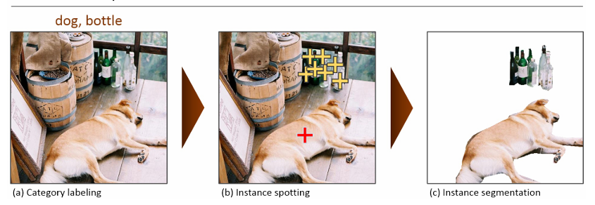
Image Annotation
Three steps with workers on Amazon’s Mechanical Turk (AMT)

Slide 14
Image Annotation
Annotation Performance Analysis:
Compared with expert workers

Slide 15
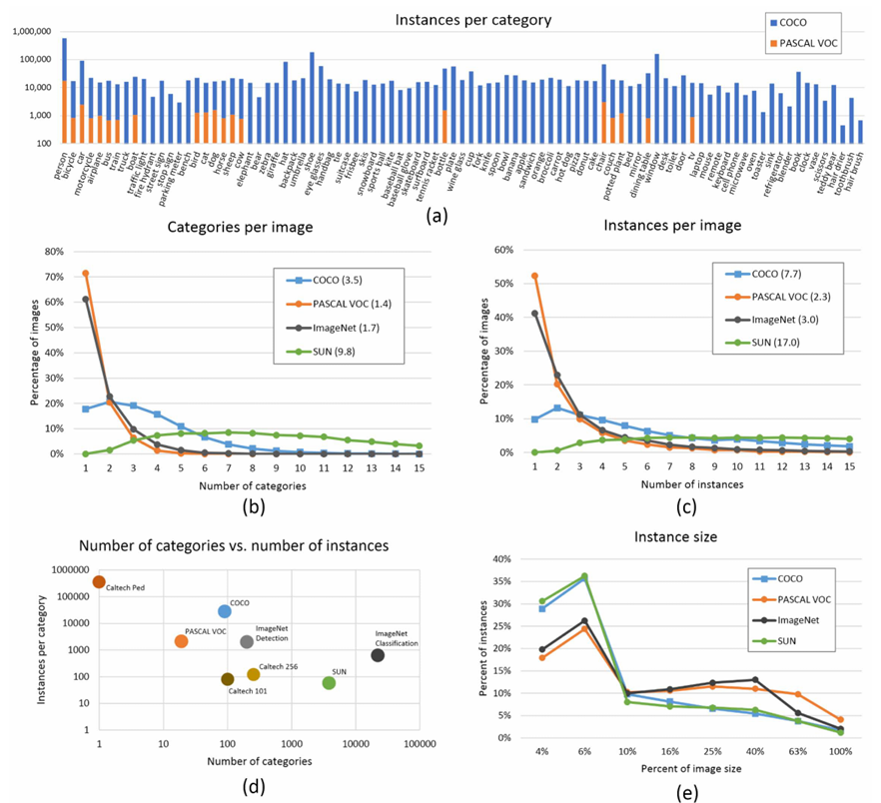
Dataset Statistics
Comparing with
ImageNet,
PASCAL VOC
and SUN

Slide 16
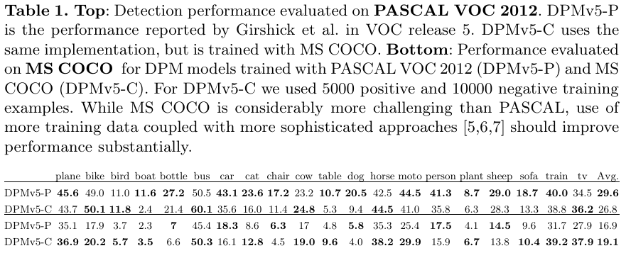
Algorithmic Analysis
Bounding-box Detection

Slide 17
Algorithmic Analysis
Generating Segmentations from Detections
Detection Evaluated by Segmentation

Slide 18
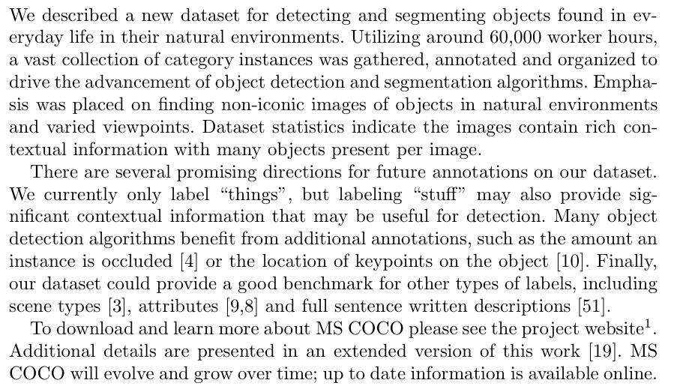
Discussion

Slide 19
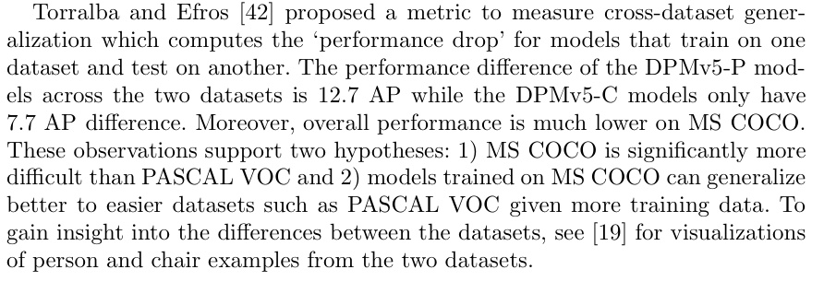
Reflection
No “stuff” annotated in a dataset featuring context reasoning
Cannot see overperformance when comparing with PASCAL VOC

Slide 20
Takeaway: How to build a benchmark
What’s the aim of your dataset?
Defining labels
Collecting photos
Annotation
How to show your benchmarks’ feature?

Slide 21
Analyzing the output
Different utility:
Accuracy
Generalization
Efficiency
Robustness
Interpretability
fairness

Slide 22
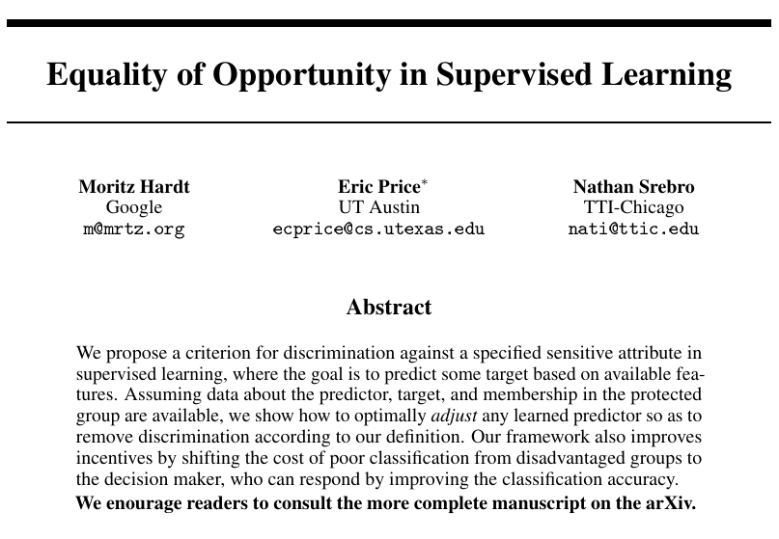
But how to build and evaluate a method?
4766cites

Slide 23
Read by parts
Introduction
Equalized odds and equal opportunity
Achieving non-discrimination
Bayes optimal predictors
Casestudy: FICO scores
Conclusion

Slide 24
Introduction
Fairness is important
Fairness through non-awareness
Demographic parity
Our contribution: a definition for better utility

Slide 25
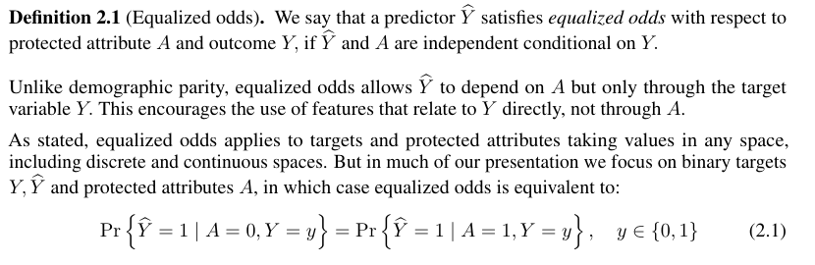
Equalized odds and equal opportunity

Slide 26
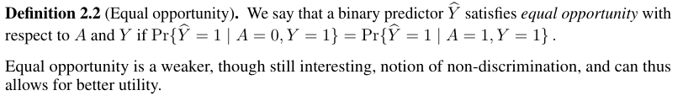

Equalized odds and equal opportunity

Slide 27
Achieving non-discrimination & Bayes optimal predictors
Basically similar to the SGD based on cost function of fairness
Too much formulas QAQ, browse via
https://proceedings.neurips.cc/paper_files/paper/2016/file/9d2682367c3935defcb1f9e247a97c0d-Paper.pdf

Slide 28
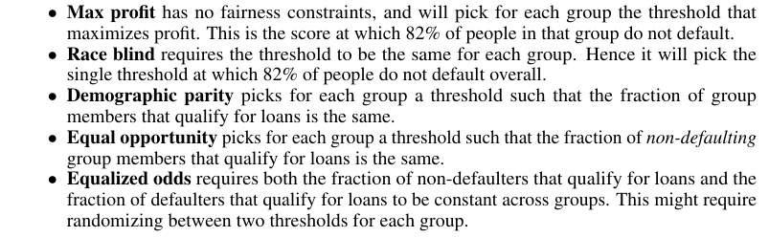
Case study: FICO scores
Using different method to predict credit worthiness

Slide 29
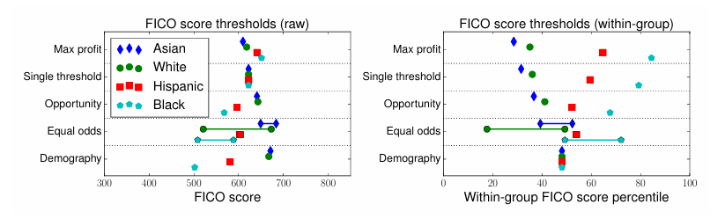

Case study: FICO scores
Outcome:

Slide 30
Conclusions
Better fitting the need of accuracy
Tips: Possible difficulty in finding labelled data

Slide 31
Takeaway
What’s your aim? Why is your method better?
Related work is necessary, no matter what the form is
A profound structure containing all definitions and claims needed
An empirical experiment to prove your method’s advantage

Slide 32
Reference
Lin, TY. et al. (2014). Microsoft COCO: Common Objects in Context. In: Fleet, D., Pajdla, T., Schiele, B., Tuytelaars, T. (eds) Computer Vision – ECCV 2014. ECCV 2014. Lecture Notes in Computer Science, vol 8693. Springer, Cham. https://doi.org/10.1007/978-3-319-10602-1_48
Hardt, M., Price, E., & Srebro, N. (2016). Equality of opportunity in supervised learning. Advances in neural information processing systems, 29.
https://www.zhihu.com

